Slide 1
Hierarchical Clustering: Time and Space requirements
O(N²) space since it uses the proximity matrix.
  N is the number of points.
O(N³) time in many cases
  There are N steps and at each step the size, N², proximity matrix must be updated and searched
  Complexity can be reduced to O(N² log(N) ) time for some approaches

Slide 2
Hierarchical Clustering: Problems and Limitations
Once a decision is made to combine two clusters, it cannot be undone
No objective function is directly minimized
Different schemes have problems with one or more of the following:
  Sensitivity to noise and outliers
  Difficulty handling different sized clusters and convex shapes
  Breaking large clusters

Slide 3
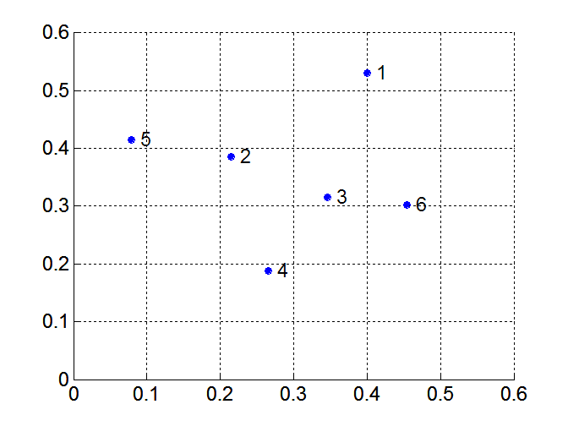
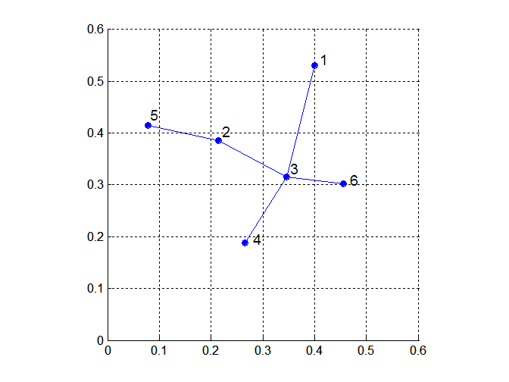
MST: Divisive Hierarchical Clustering
Build MST (Minimum Spanning Tree)
  Start with a tree that consists of any point
  In successive steps, look for the closest pair of points (p, q) such that one point (p) is in the current tree but the other (q) is not
  Add q to the tree and put an edge between p and q

Slide 4
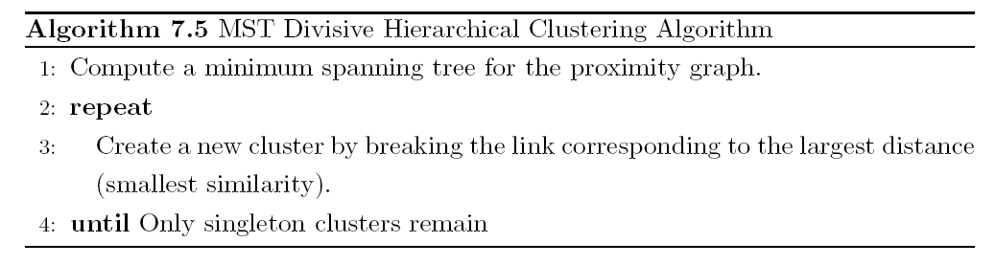
MST: Divisive Hierarchical Clustering
Use MST for constructing hierarchy of clusters

Slide 5
DBSCAN
DBSCAN is a density-based algorithm.
  Density = number of points within a specified radius (Eps)
  A point is a core point if it has more than a specified number of points (MinPts) within Eps
    These are points that are at the interior of a cluster
  A border point has fewer than MinPts within Eps, but is in the neighborhood of a core point
  A noise point is any point that is not a core point or a border point.

Slide 6

DBSCAN: Core, Border, and Noise Points

Slide 7
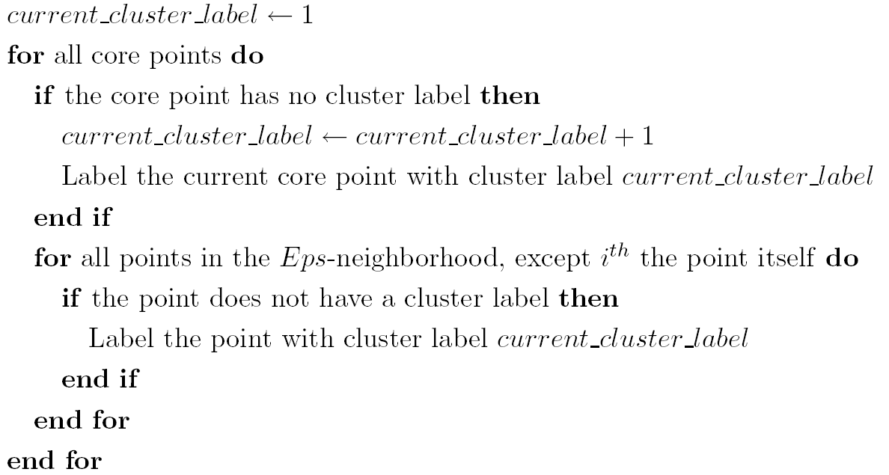
DBSCAN Algorithm
Eliminate noise points
Perform clustering on the remaining points

Slide 8


DBSCAN: Core, Border and Noise Points
Original Points
Point types: core, border and noise
Eps = 10, MinPts = 4

Slide 9

When DBSCAN Works Well
Original Points
Clusters
Resistant to Noise
Can handle clusters of different shapes and sizes

Slide 10



When DBSCAN Does NOT Work Well
(MinPts=4, Eps=9.75).
Original Points
Varying densities
High-dimensional data
(MinPts=4, Eps=9.92)

Slide 11
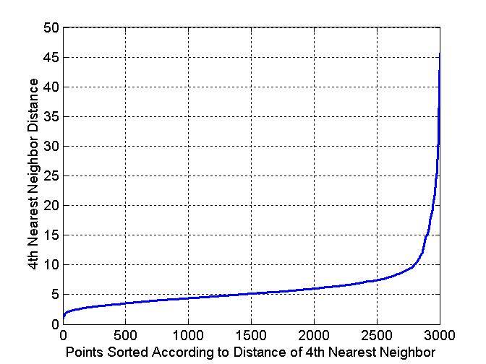
DBSCAN: Determining EPS and MinPts
Idea is that for points in a cluster, their k^{th} nearest neighbors are at roughly the same distance
Noise points have the k^{th} nearest neighbor at farther distance
So, plot sorted distance of every point to its k^{th} nearest neighbor

Slide 12
Cluster Validity
For supervised classification we have a variety of measures to evaluate how good our model is
  Accuracy, precision, recall
For cluster analysis, the analogous question is how to evaluate the “goodness” of the resulting clusters?
But “clusters are in the eye of the beholder”!
Then why do we want to evaluate them?
  To avoid finding patterns in noise
  To compare clustering algorithms
  To compare two sets of clusters
  To compare two clusters

Slide 13
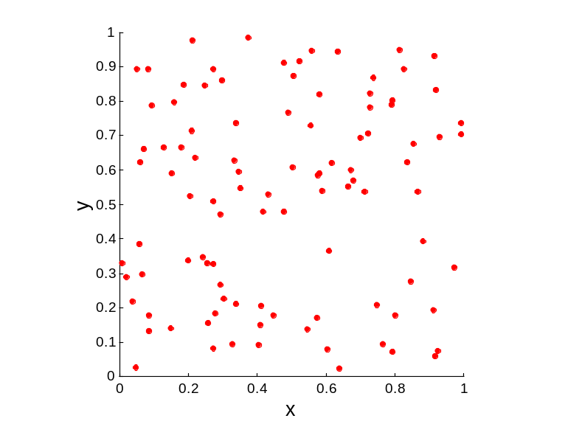
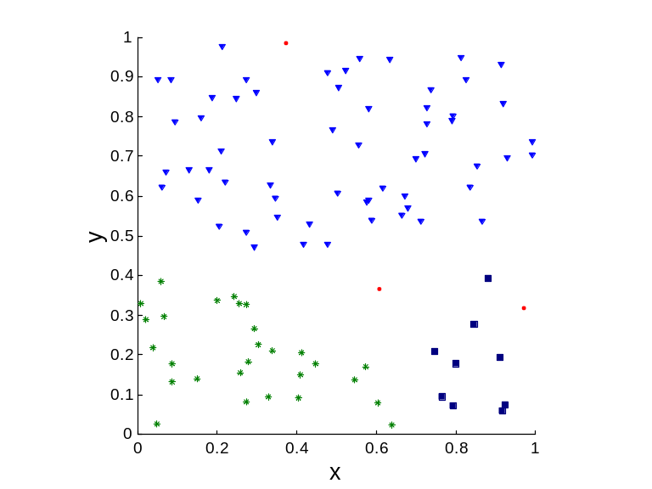
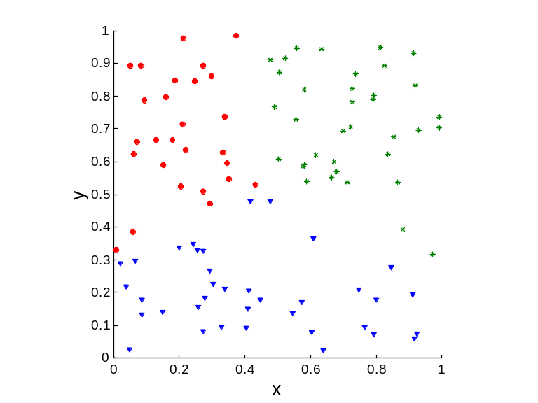
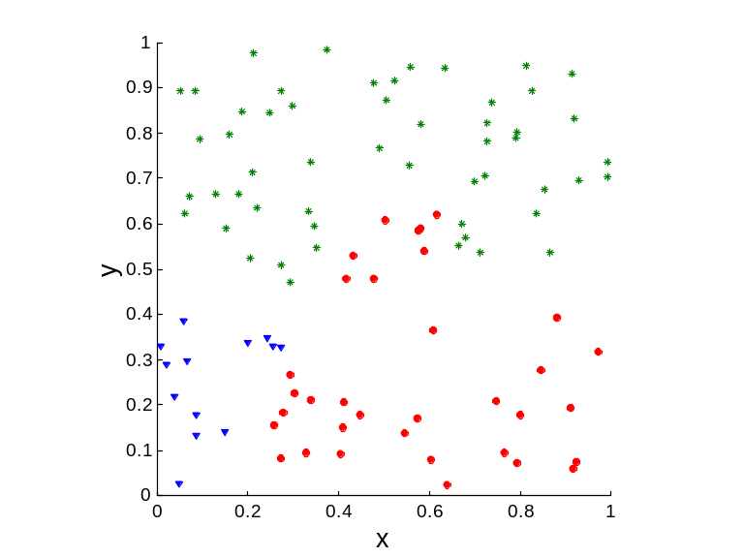
Clusters found in Random Data
Random Points
DBSCAN
K-means
Complete Link

Slide 14
Different Aspects of Cluster Validation
Determining the clustering tendency of a set of data, i.e., distinguishing whether non-random structure actually exists in the data.
Comparing the results of a cluster analysis to externally known results, e.g., to externally given class labels.
Evaluating how well the results of a cluster analysis fit the data without reference to external information.
  - Use only the data
Comparing the results of two different sets of cluster analyses to determine which is better.
Determining the ‘correct’ number of clusters.
For 2, 3, and 4, we can further distinguish whether we want to evaluate the entire clustering or just individual clusters.

Slide 15
Measures of Cluster Validity
Numerical measures that are applied to judge various aspects of cluster validity, are classified into the following three types.
  External Index: Used to measure the extent to which cluster labels match externally supplied class labels.
    Entropy
  Internal Index: Used to measure the goodness of a clustering structure without respect to external information.
    Sum of Squared Error (SSE)
  Relative Index: Used to compare two different clusterings or clusters.
    Often an external or internal index is used for this function, e.g., SSE or entropy
Sometimes these are referred to as criteria instead of indices
  However, sometimes criterion is the general strategy and index is the numerical measure that implements the criterion.

